Slide 1
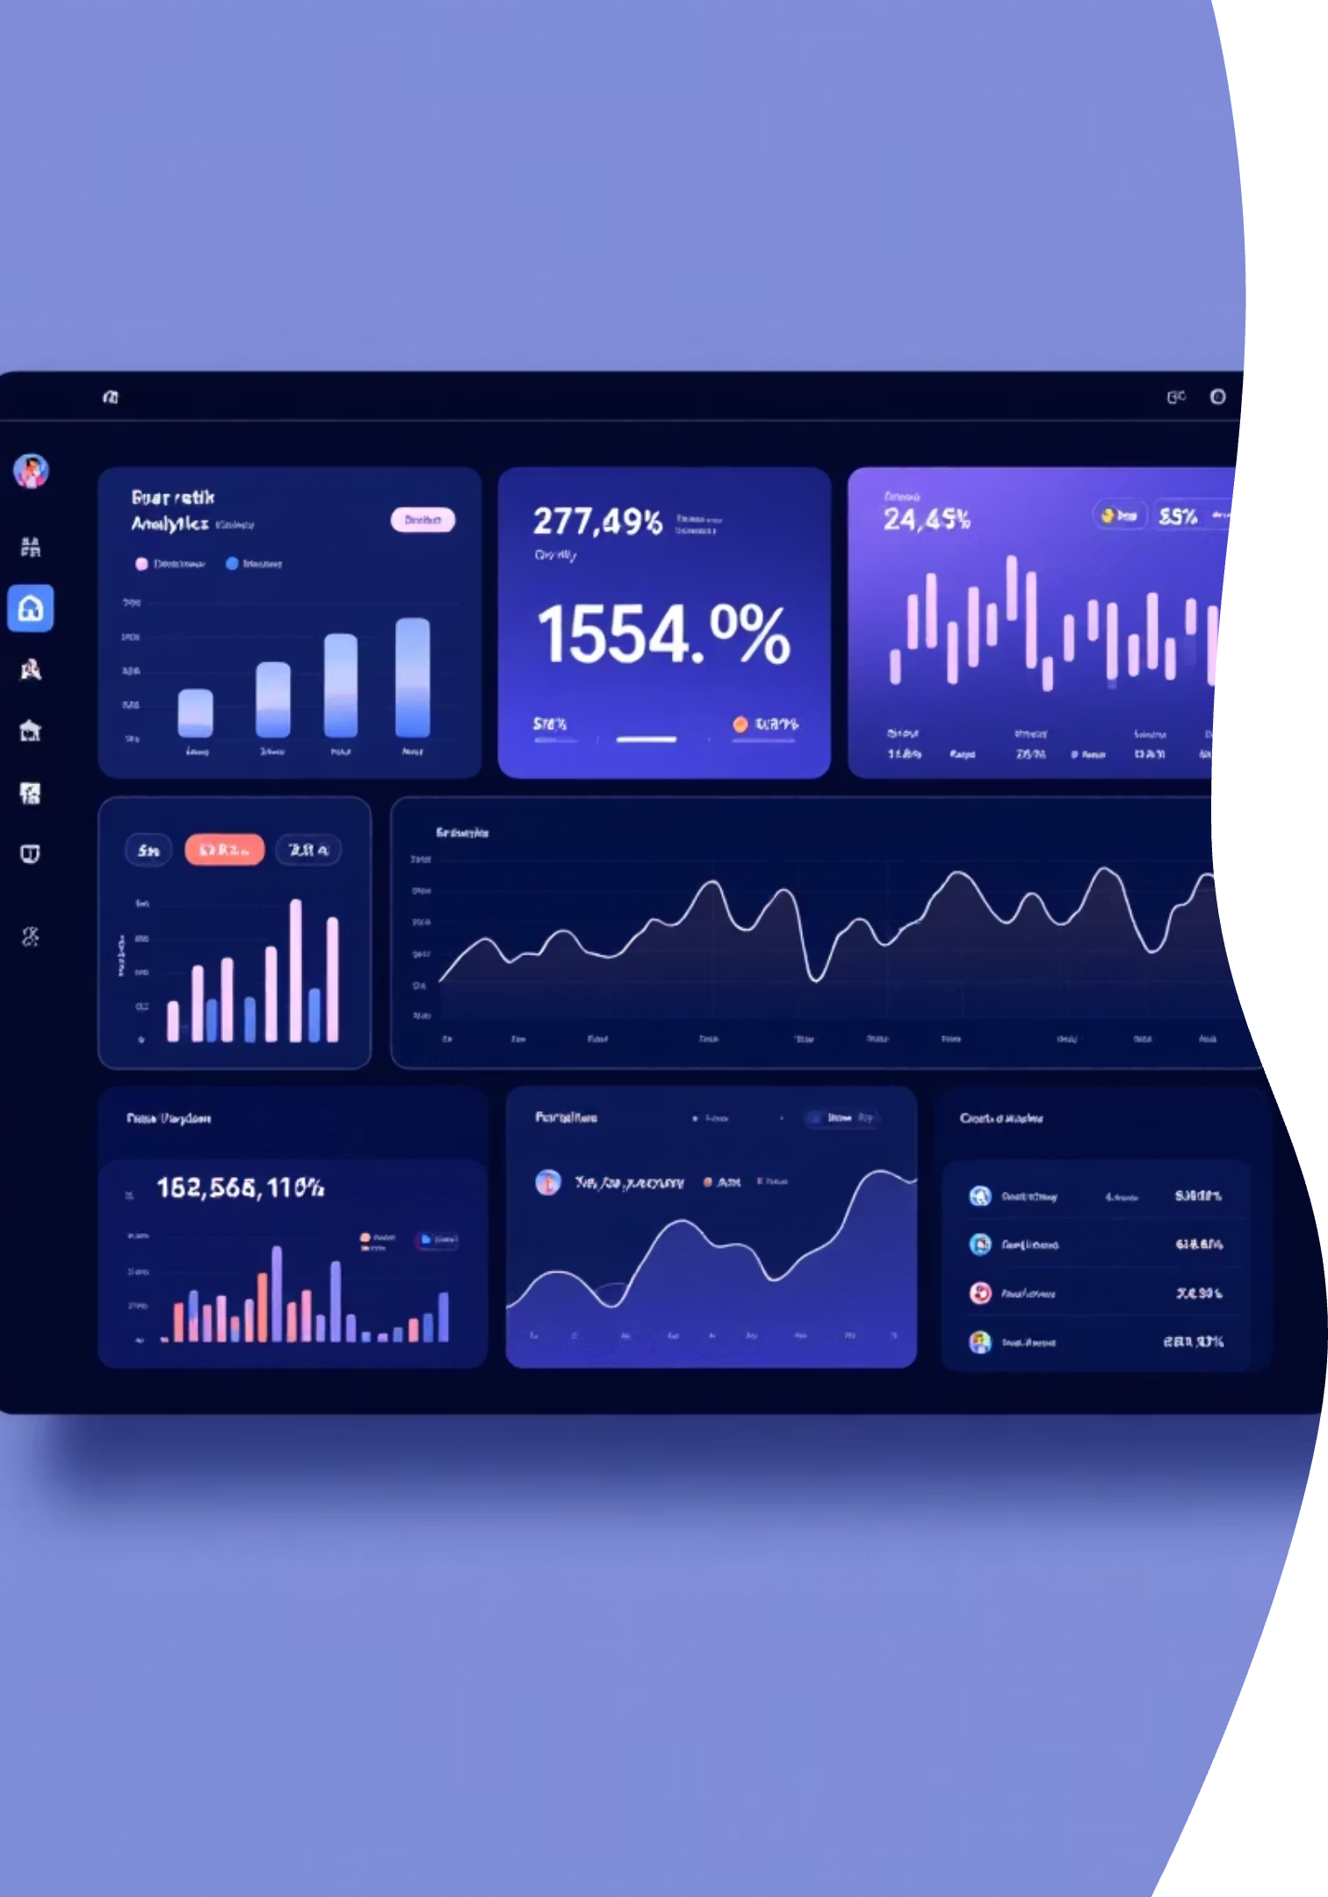
Customer Shopping Behavior Analysis
Uncovering insights from 3,900 purchases to drive strategic business decisions

Slide 2
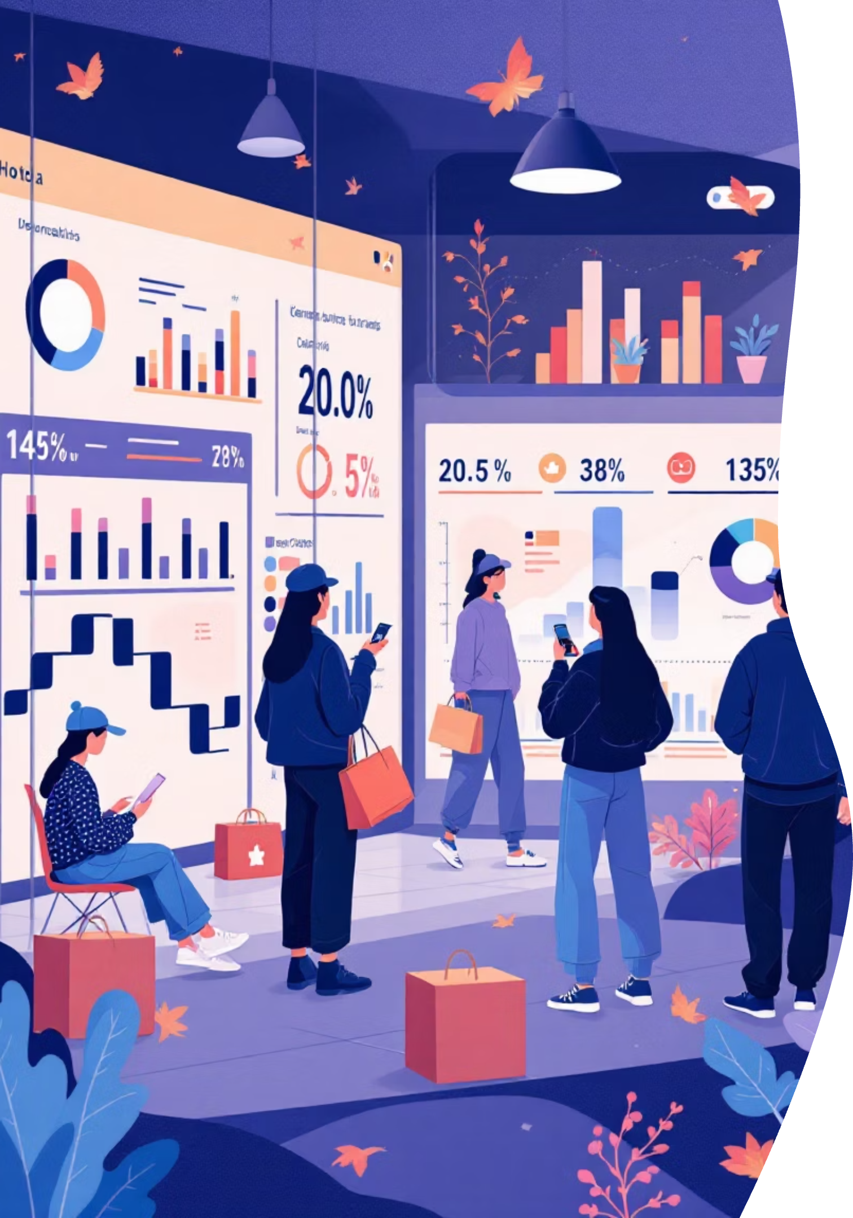
Dataset Overview
3,900
18
50
Total Purchases
Data Points
Locations
Transactions analyzed across all categories
Features tracked per customer
Geographic coverage
25
Products
Unique items purchased

Slide 3
Data Preparation Journey
01
02
Data Loading & Exploration
Missing Data Handling
Imported dataset, analyzed structure and summary statistics
Imputed 37 missing review ratings using category medians
03
04
Feature Engineering
Database Integration
Created age groups and purchase frequency metrics
Connected to PostgreSQL for advanced analysis

Slide 4
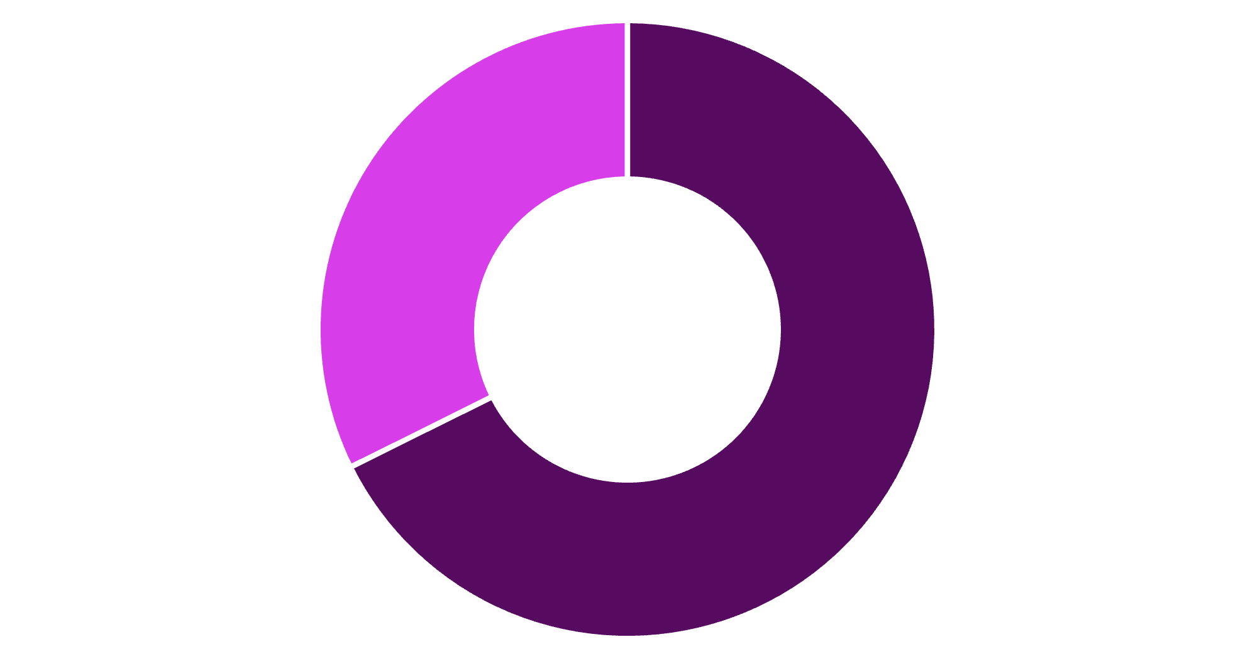
Revenue by Gender
Key Insight
Male customers generate 68% of total revenue, significantly outpacing female shoppers.
Consider targeted campaigns to increase female customer engagement and spending.
Male
Female

Slide 5

Customer Segmentation
Loyal Customers
Returning Buyers
New Customers
3,116 customers
701 customers
83 customers
Highest value segment with consistent purchase history
Growing segment showing repeat behavior
Fresh acquisition opportunity
80% of customers are already loyal – focus on retention and moving returning buyers into this segment

Slide 6

Top Performing Products
Highest Rated Items
Best Sellers by Category
Gloves – 3.86 rating
Accessories: Jewelry (171 orders)
Sandals – 3.84 rating
Boots – 3.82 rating
Clothing: Blouse & Pants (171 each)
Hat – 3.80 rating
Skirt – 3.78 rating
Footwear: Sandals (160 orders)
Outerwear: Jacket (163 orders)

Slide 7



Subscription Impact Analysis
27%
$59.49
$59.87
Subscription Rate
Subscriber Spend
Non-Subscriber Spend
1,053 of 3,900 customers subscribed
Average purchase amount
Slightly higher average
958 repeat buyers (>5 purchases) are subscribers – strong correlation between loyalty and subscription status

Slide 8

Discount Strategy Insights
Discount-Dependent Products
High-Value Discount Users
839 customers used discounts but still spent above average ($59.76)
Hat – 50%
These savvy shoppers respond to promotions while maintaining high purchase values
Sneakers – 49.66%
Coat – 49.07%
Sweater – 48.17%
Pants – 47.37%

Slide 9
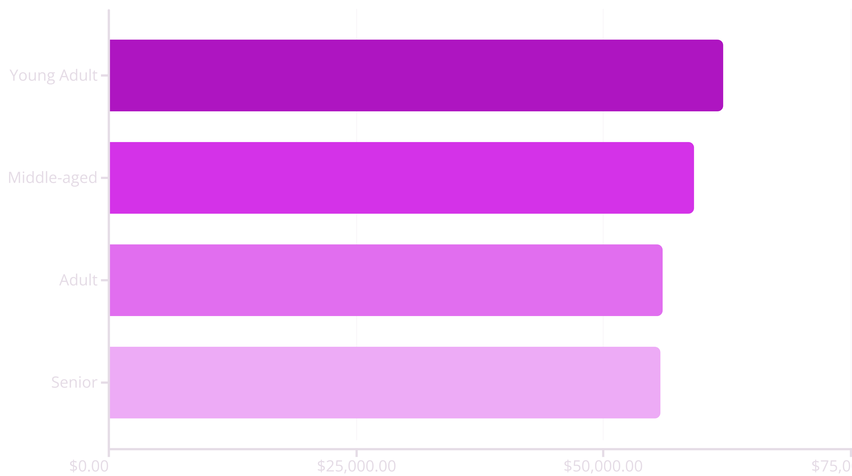
Revenue Distribution
Young adults lead revenue generation, but all age groups contribute relatively evenly – opportunity for age-specific marketing

Slide 10
Strategic Recommendations
1
2
3
Boost Subscriptions
Loyalty Programs
Optimize Discounts
Promote exclusive benefits to increase 27% subscription rate
Reward repeat buyers to accelerate movement into loyal segment
Balance promotional sales with margin control on high-discount items
4
5
Product Positioning
Targeted Marketing
Highlight top-rated items like gloves and sandals in campaigns
Focus on high-revenue demographics and express shipping users

